Slide 1
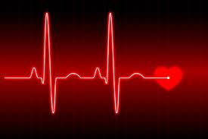
“I’ve heard a murmur…”
Now what?
A presentation by the founders of CHD Warriors

Slide 2
Congratulations! You are welcoming a new wonder into your life. Everything is perfect. Until you hear…

Slide 3
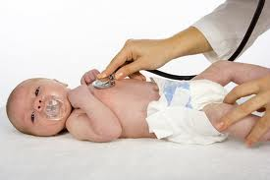
“I’ve heard a murmur…” Those words can be terrifying to a parent. But don’t panic, more often than not it’s nothing to worry about.

Slide 4
All babies have a “hole” in their heart. (indicated by blue arrows) It usually closed before birth. Sometimes it will linger open after birth. This hole can be the source of the murmur that the doctor heard during your babies initial exam after birth.

Slide 5
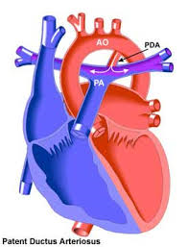
The “hole” is called a patent ductus arteriosus or PDA for short. When babies are in the womb this hole is connects the two major arteries (pulmonary and aorta) and diverts the oxygenated blood away from the unused lungs and sending it directly to the body. Sometimes a baby is a little slow getting this hole closed before birth. Not to worry. It is not unusual and will typically close within 24-72 hrs. causing no harm to your child.

Slide 6
So what happens now?

Slide 7
Ultrasound
An ultrasound of your babies heart is the next step. This will determine if it’s a simple PDA or something more.

Slide 8
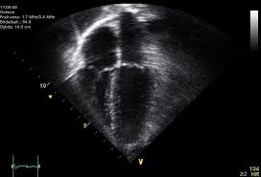
An ultrasound will give the Dr. a picture of the heart to look at. From this he can see what the cause of the murmur could be. Sound waves bounce back an image of the heart showing exactly how it is functioning.

Slide 9
If you are one of the many that have the murmur turn out to be nothing to worry about, then congratulations. I’m sure you will be breathing a huge sigh of relief. Go home and spoil your baby with love. This will become a distant memory. However if you are 1 in 100, then your baby will be needing a little more help and, so will you.

Slide 10
If the results from the ultrasound showed something other than a PDA, then what happens next? I’m sure a million questions are running through your mind. Hopefully, this will help you understand a bit better.

Slide 11
An echocardiogram will be performed. This is very similar to an ultrasound. It shows the blood flow through the chambers and arteries of the heart. Blue being oxygenated and red un-oxygenated.
The results will be read by a cardiologist to ensure accuracy and for a diagnosis.

Slide 12
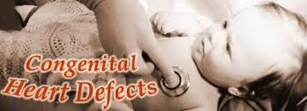
What follows next will vary from baby to baby. It is quite likely that your baby will be 1 in 100 babies born every year with some type of congenital heart defect or CHD for short. There are over 40 types of CHD’s. The cardiologist who reads your baby’s echo will identify which it may be. Some will require immediate surgery, others can wait till later in life. Again the cardiologist will let you know further on this.

Slide 14
https://www.facebook.com/pages/CHD-Warriors/110794989089445 for more information on CHD’s and to speak to families just like you.
It is important for you to understand that this is a stressful situation to be in but know that there are others out there dealing with the very same thing. There are parents willing to offer support and advice who are in similar situations.

